Slide 1
Fundamentals of git and GitHub
SERC Data Science Series
Abby Lewis
17 June 2025

Slide 2
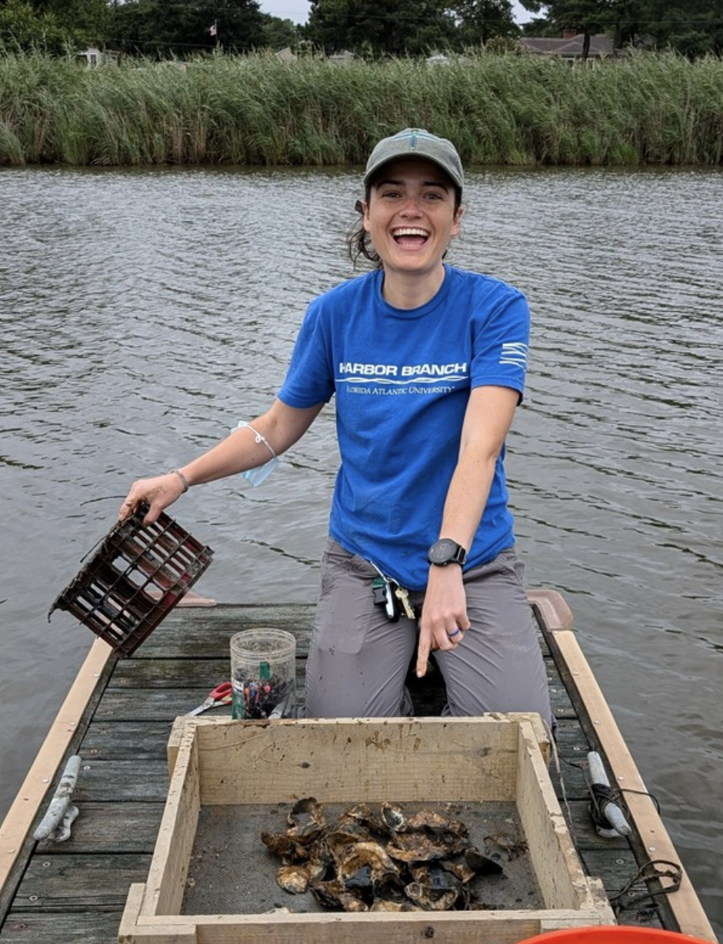



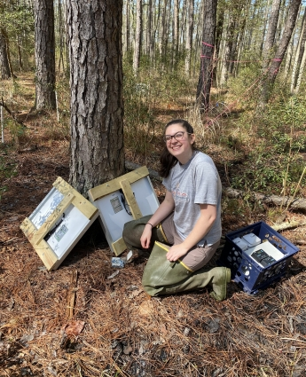
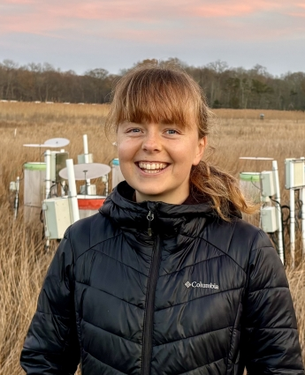
Summer Data Science Series
Sarah Goodnight
Mary Cortese
Michael Lonneman
June 17: Fundamentals of Git and GitHub
July 1: Intro to R Shiny
Michael Lonneman
July 15: Geospatial part 1
Mary Cortese
July 29: Geospatial part 2
Mary Cortese
August 12: Advanced data visualization and reports
Jaxine Wolfe
Jaxine Wolfe
Rose Cheney
Abby Lewis

Slide 3

version control
collaboration
backups
reproducibility

Slide 4
Objectives
By the end of the workshop, you will be able to:
Understand and execute a foundational GitHub workflow (pull, commit, push)
Explain the purpose of forks and branches
Describe tools for collaboration in GitHub, including issues and documentation

Slide 5



GitHub = service on the web
LOCAL
REMOTE

Slide 6

“repository”
LOCAL
REMOTE

Slide 7
“repository”
clone
LOCAL
REMOTE

Slide 8
git pull
“repository”
LOCAL
REMOTE

Slide 9
git pull
“repository”
git commit
LOCAL
REMOTE

Slide 10

git pull
“repository”
git commit (again)
LOCAL
REMOTE

Slide 11
git pull
“repository”
git push
git commit
LOCAL
REMOTE

Slide 12
“repository”
(including commit history)
git pull
git push
git commit
LOCAL
REMOTE

Slide 13
Benefits of this workflow
FOR YOU:
Version control (commits = “checkpoints”)
You can restore back to what the repository looked like at that commit
Commit titles provide documentation
Back up your work!
FOR OTHERS:
GitHub provides a platform for collaborators to build off your code

Slide 14
Let’s try it!
Navigate to your profile on github.com
Create a repository
git pull
Make local changes
git commit
git push

Slide 15
“repository”
(including commit history)
git pull
git push
git commit
LOCAL
REMOTE

Slide 16
REMOTE
“repository”
(including commit history)
LOCAL1
LOCAL2

Slide 18
Merge conflicts
How to avoid
Communicate with team about who is working on what and when
Save/push your changes at appropriate times
Use branches and forks

Slide 19
“Branches” allow you to explore options
“development” branches
branch
merge/pull request
repository
“main” branch
“main” branch
This exists as part of the repository on BOTH the local and remote versions
Notes:
Could be two different people

Slide 20
Fork repositories to make a personal copy
abbylewis/repository1
Repositories stored on my GitHub account (abbylewis)
Repositories stored on your GitHub account

Slide 21

Fork repositories to make a personal copy
“upstream”
fork
1
abbylewis/repository1
username/repository1
Repositories stored on my GitHub account (abbylewis)
Repositories stored on your GitHub account

Slide 22
“Pull request” to contribute your changes
fork
1
abbylewis/repository1
username/repository1
pull request
Repositories stored on my GitHub account (abbylewis)
Repositories stored on your GitHub account

Slide 23
Let’s try it!
Navigate to https://github.com/smithsonian/SERC_Data_Science
Fork the repository
git pull
Make a new branch
Make changes
git commit
git push
Create a pull request

Slide 25
Collaboration and documentation
Readmes
Issues
Assign (@, which you can do in commit too)
https://github.com/ikatyang/emoji-cheat-sheet/blob/master/README.md
Can add issue # to commit
What goes on github?
Code
Data? Not massive files
Think carefully about pushing figures, powerpoints, etc
Are there other places these should go?

Slide 26
Resources
Star repositories
Teun
https://docs.github.com/en
https://skills.github.com/

